Slide 1

The Origin of DAO
Jademont Zheng
Founding Partner of Waterdrip Capital
Committee Member of BitShares

Slide 2
Outline
Before DAO
From Bitcoin to BeyondBitcoin
BitShares & Ethereum
BitShares DAO introduction

Slide 3
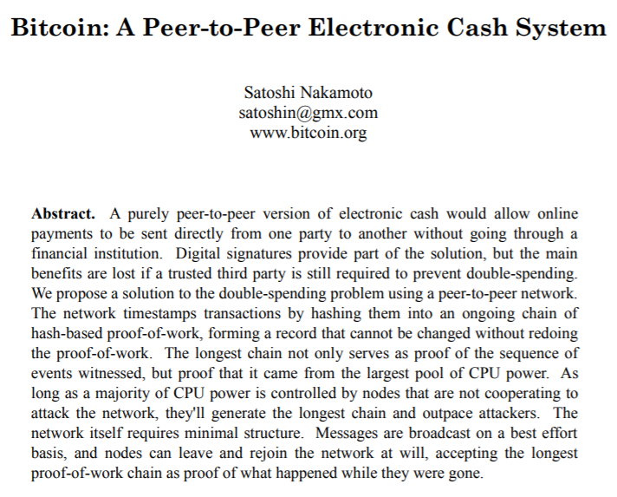
Before DAO
Bitcoin
Whitepaper ←→ Constitution
Employee ←→ Miner
Raw Material ←→ Electricity
Salary ←→ BTC
Product ←→ E-cash System
Customers ←→ All users
However, bitcoin is of low speed and lack of flexibility.

Slide 4
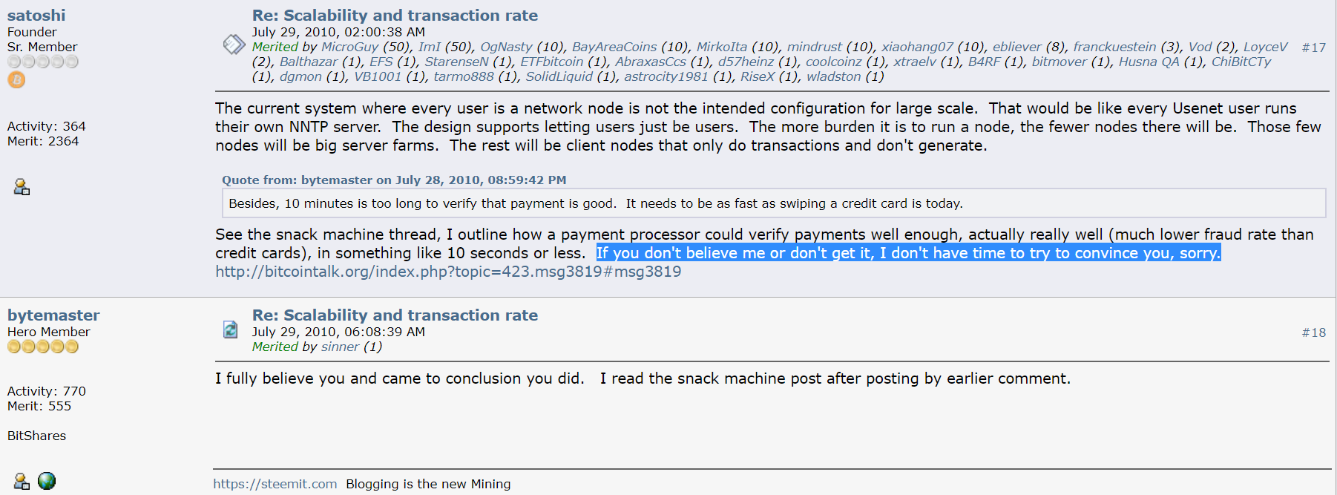
From Bitcoin to BeyondBitcoin
Satoshi:
If you don’t believe me or don’t get it, I don’t have time to try to convince you, sorry.
https://bitcointalk.org/index.php?topic=532.msg6269#msg6269

Slide 5

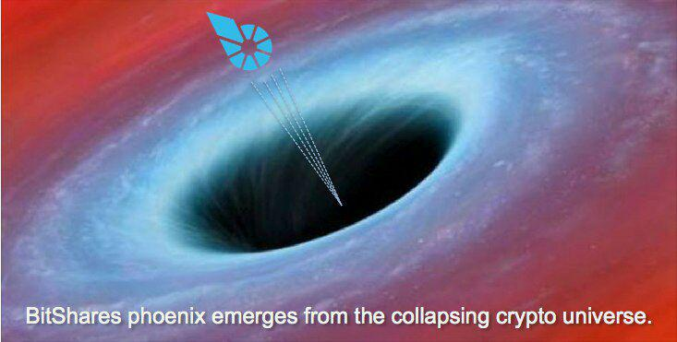

BitShares---The First DAO

Slide 6
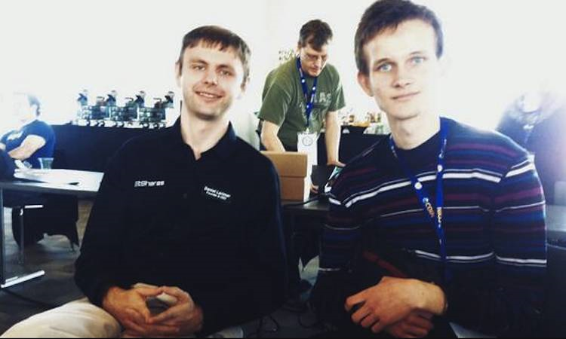
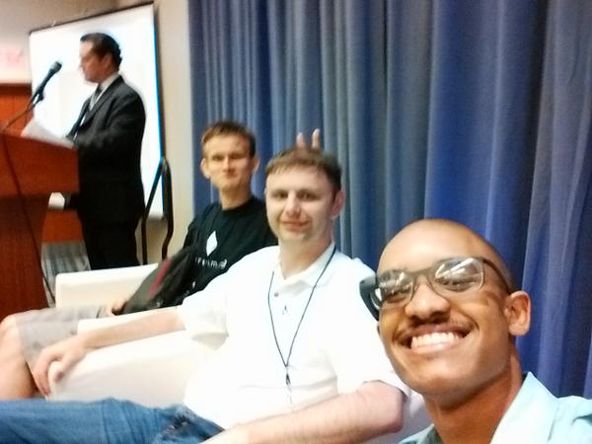
BitShares & Ethereum
Old days in 2014

Slide 7
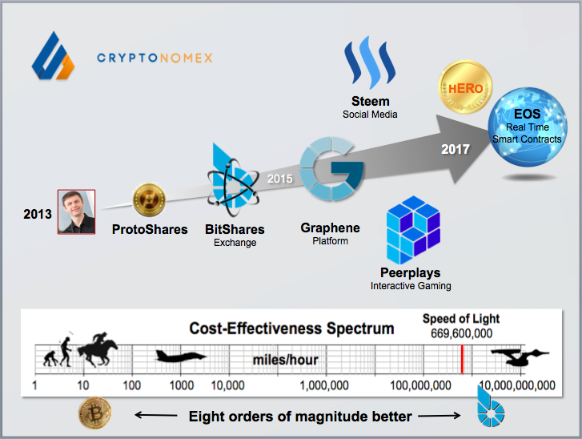
BitShares---The First DAO

Slide 8
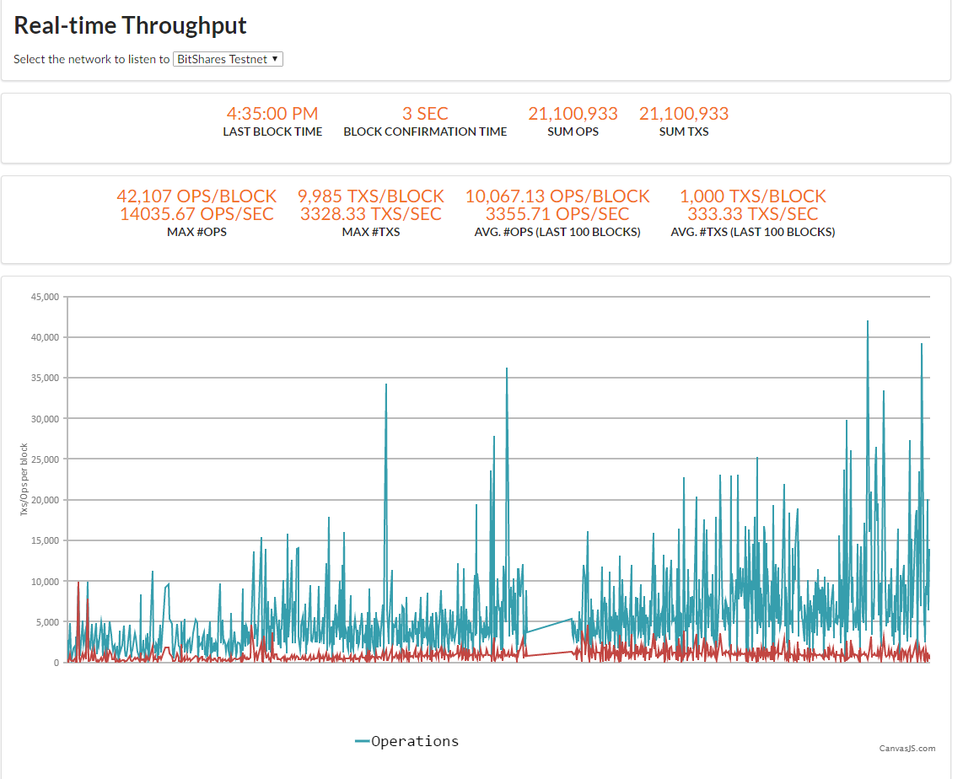
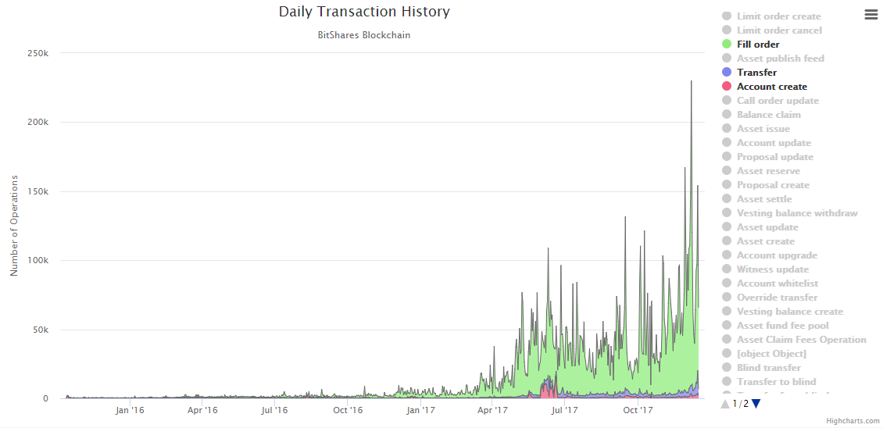
BitShares Key features
Qualified for industrial applications: 3300 up to 100000 tps

Slide 9
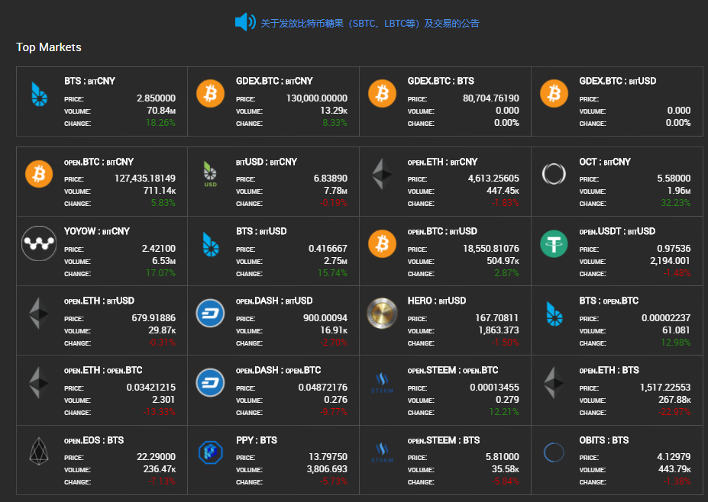
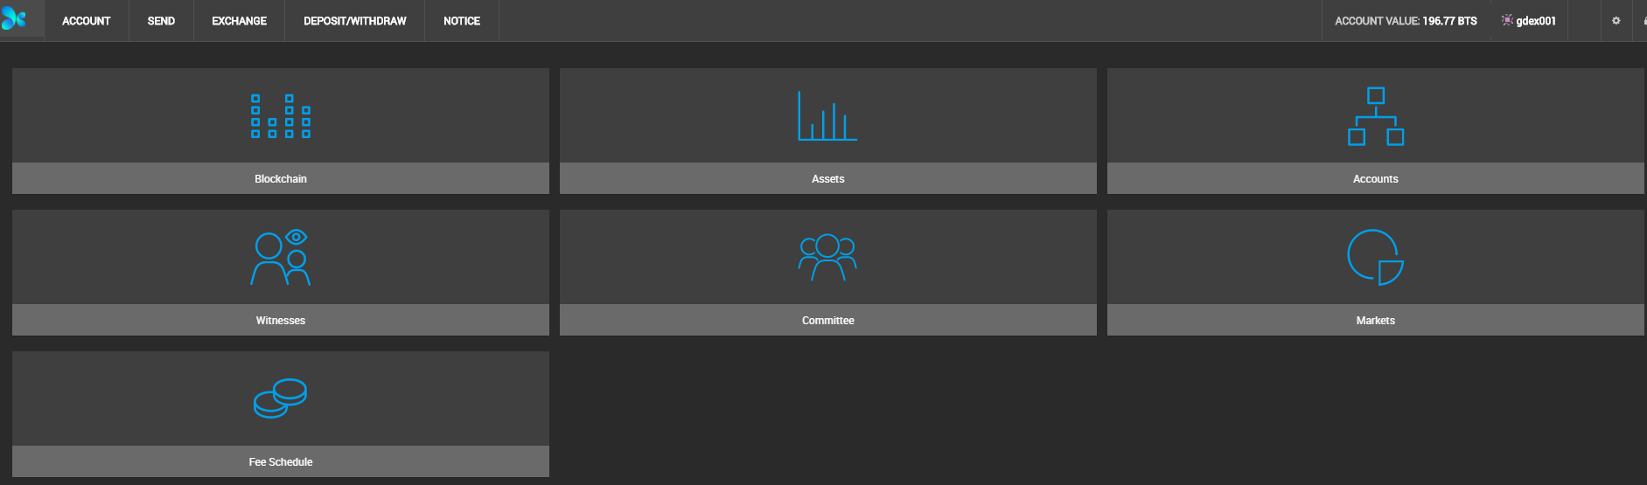
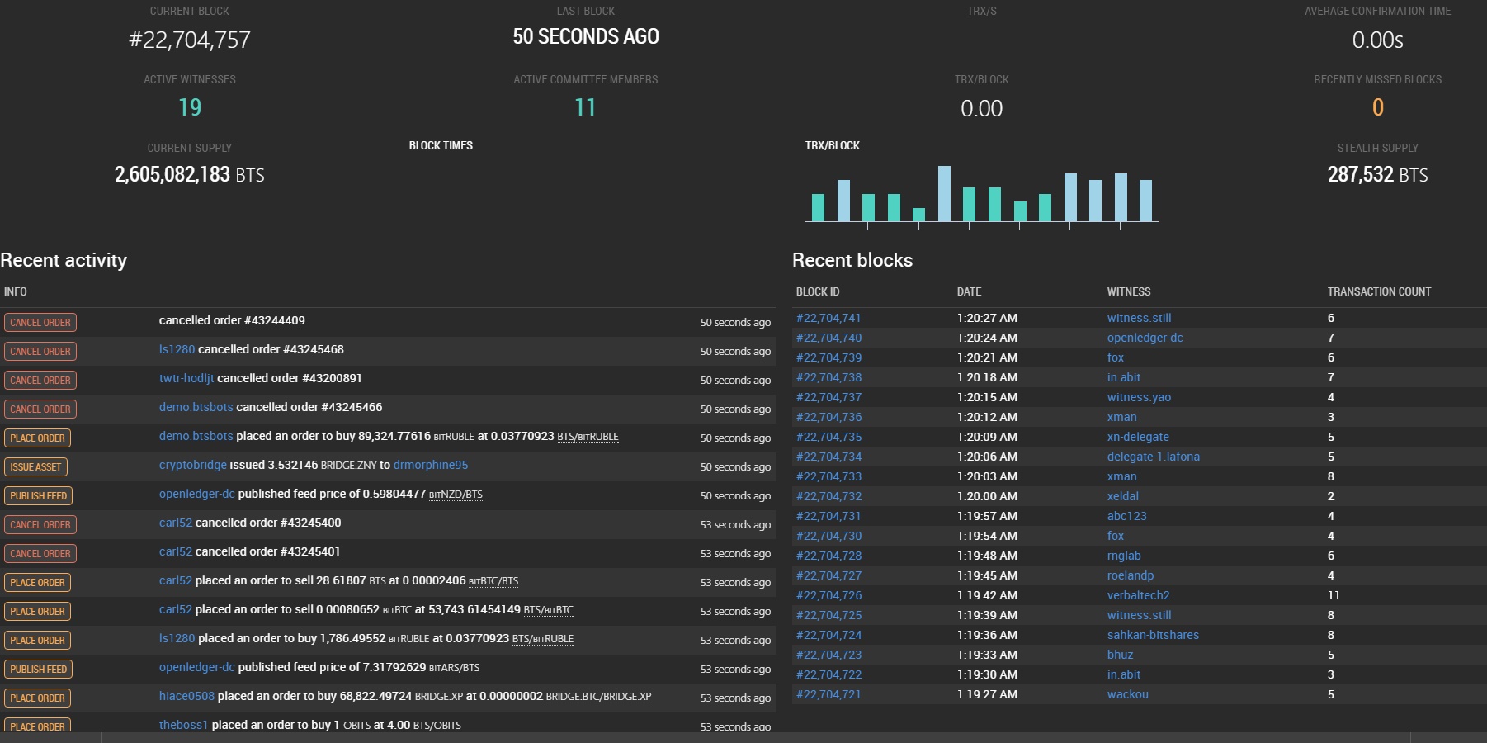
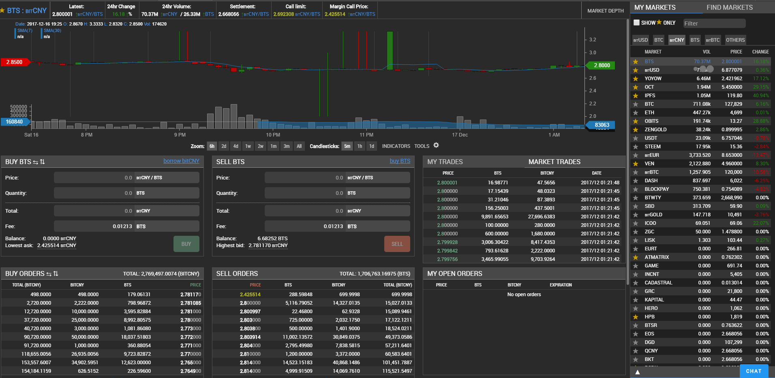
BitShares Governance

Slide 10
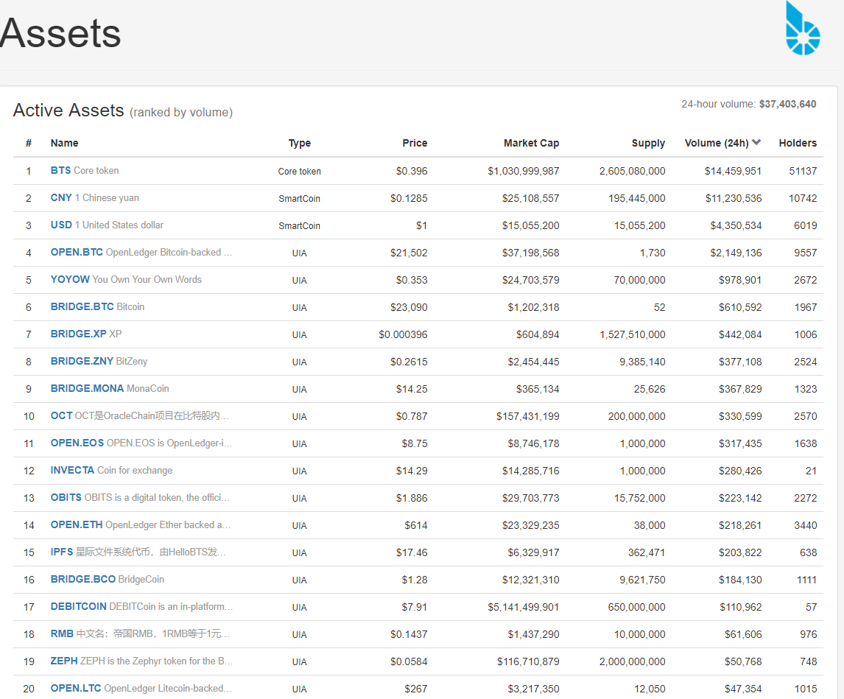
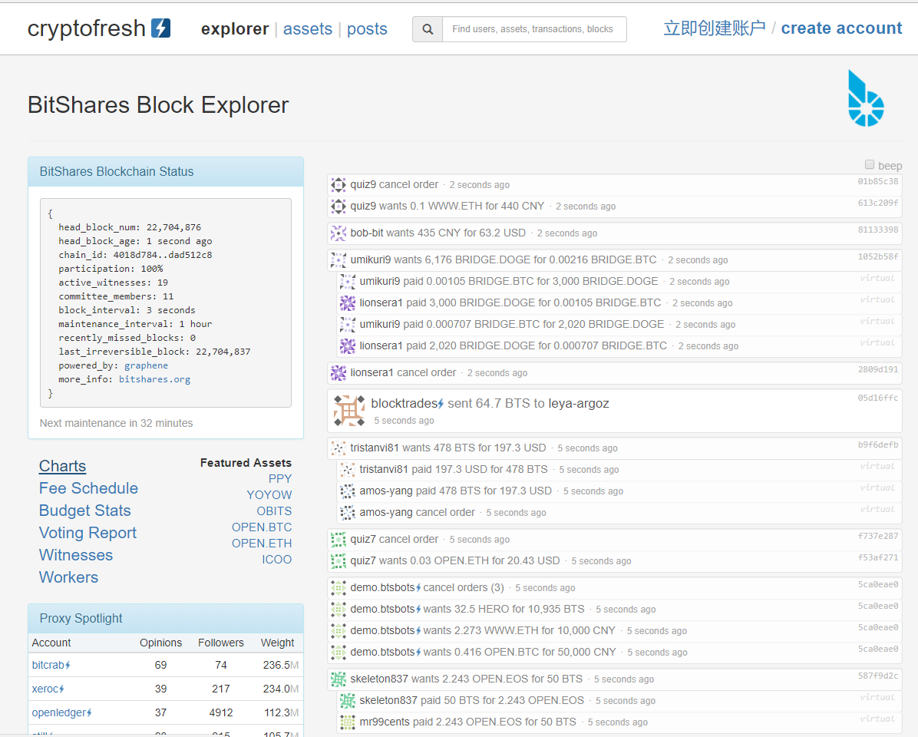
BitShares DATA

Slide 11
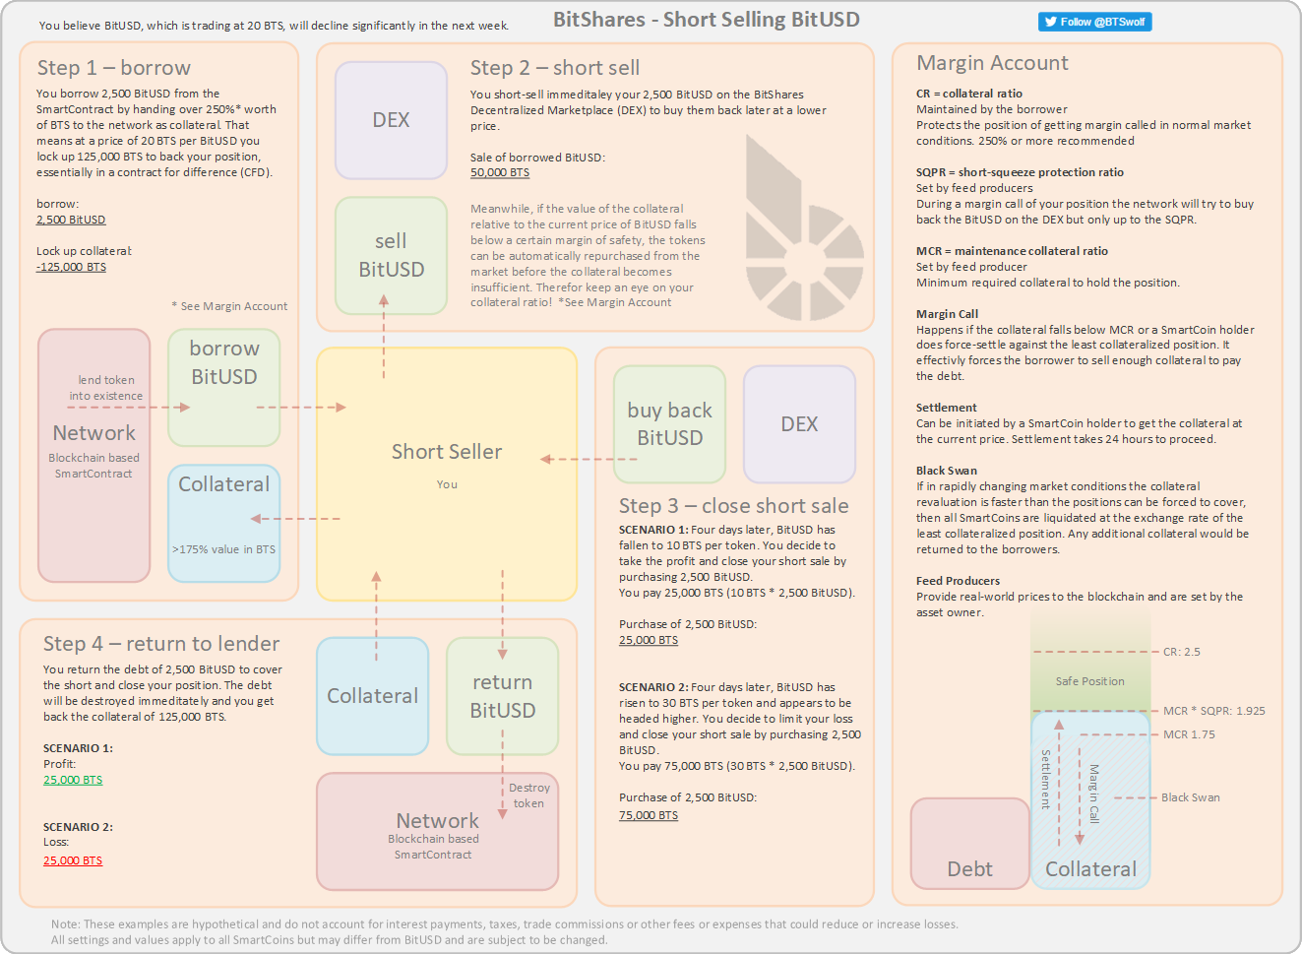
BitShares Economic Mechanism

Slide 12
DAC DAO and DAS
Decentralized Autonomous Corporation
Decentralized Autonomous Organization
Decentralized Autonomous Society

Slide 13
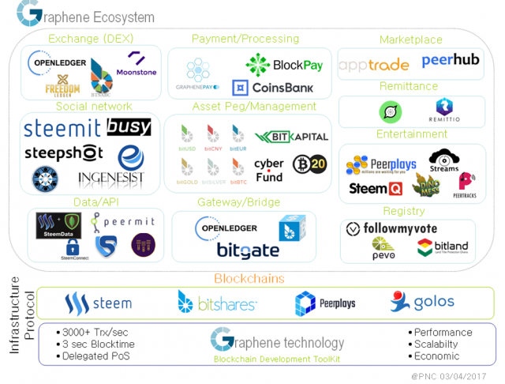
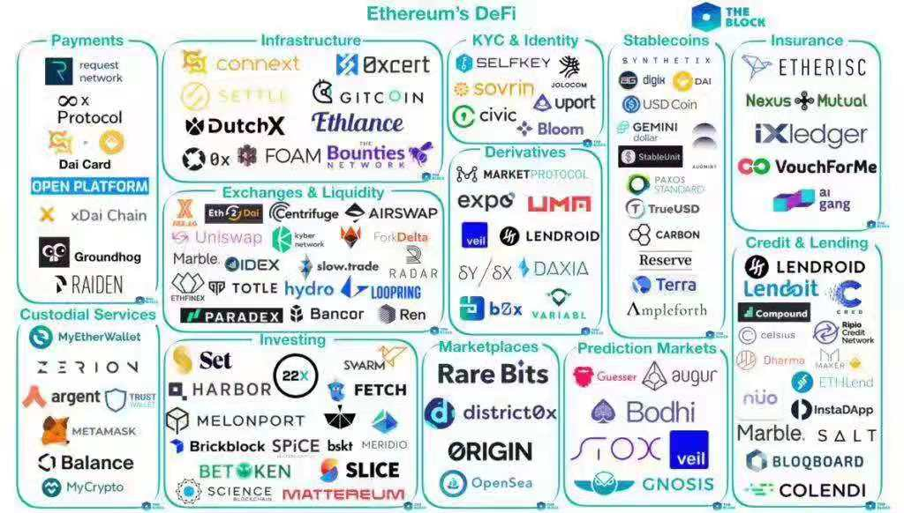
A Comparison Between Graphene & Ethereum

Slide 14
Thank you !

